Slide 2
Digital Forensics Lecture-13
By- Dr.subhranil Das
Assistant Professor
School of computer Science

Slide 3

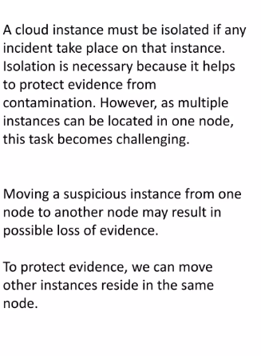
Isolating Cloud Instance

Slide 4
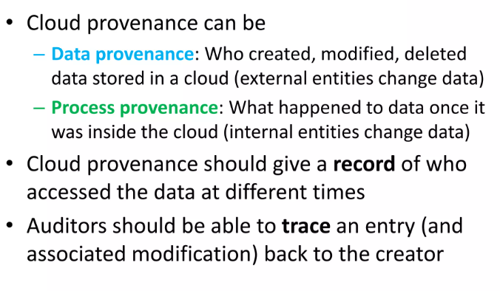
Cloud Provenance

Slide 5
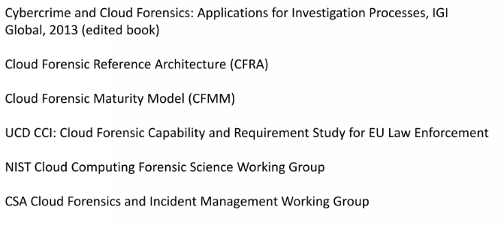
Current Work

Slide 6
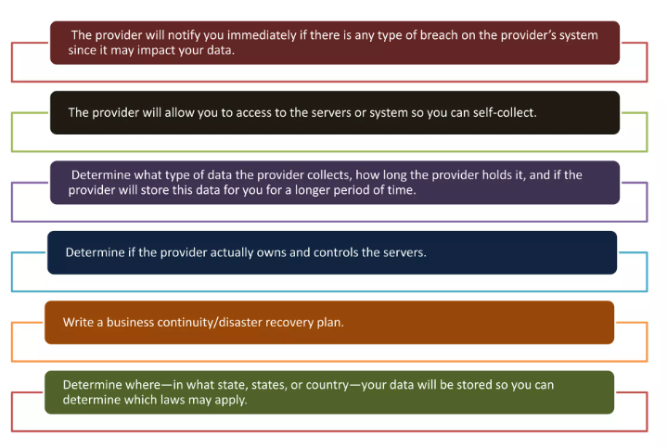
Considerations for Service Provider

Slide 7
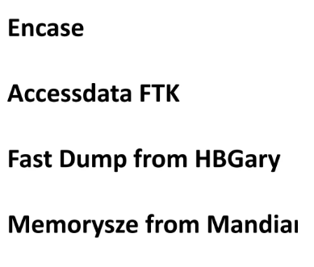
Evaluation of Current Forensic Tools in Cloud

Slide 8
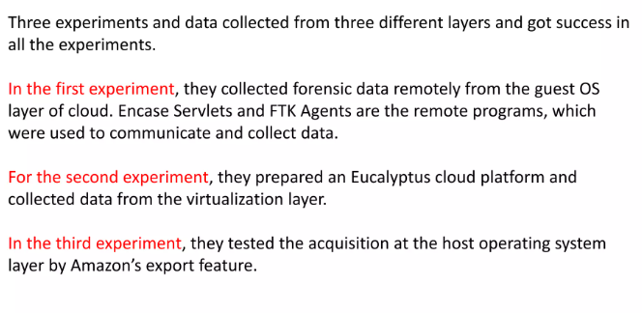
Evaluation of Current Forensic Tools in Cloud

Slide 9
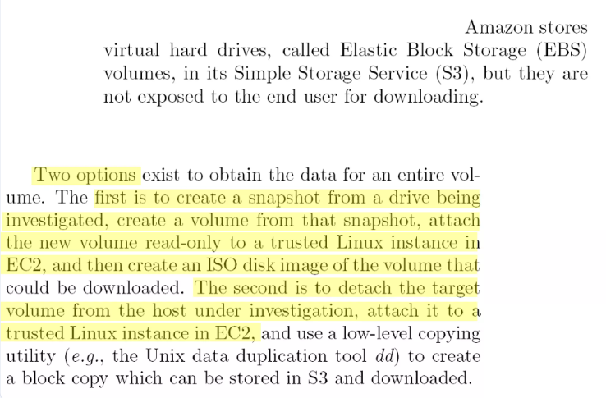
Extracting data from Amazon EC2

Slide 10
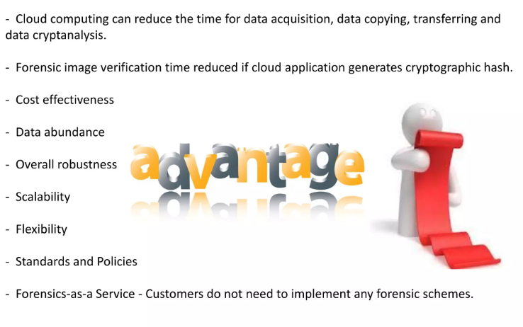

Slide 11
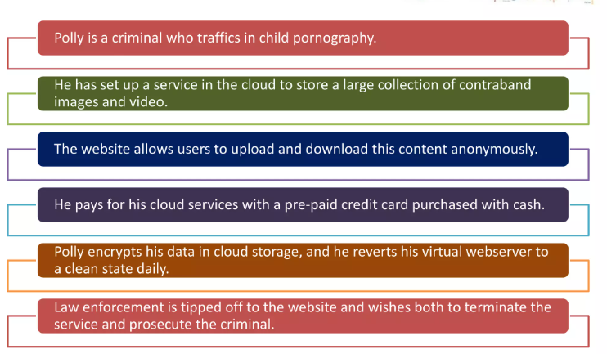
Polly

Slide 12
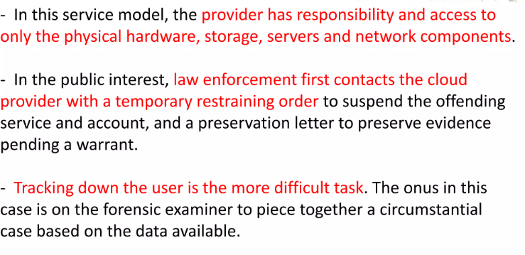
IaaS Service Model

Slide 13
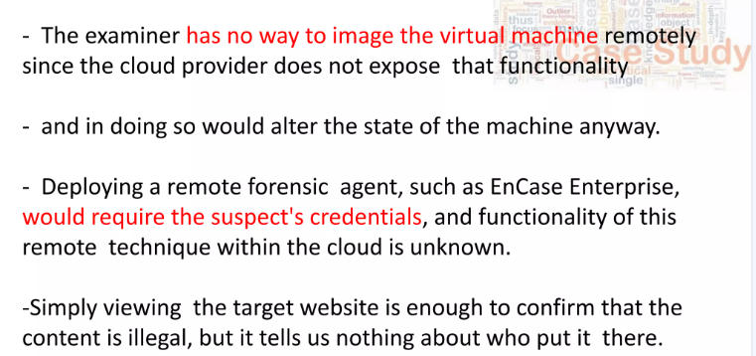
IaaS Service Model

Slide 14
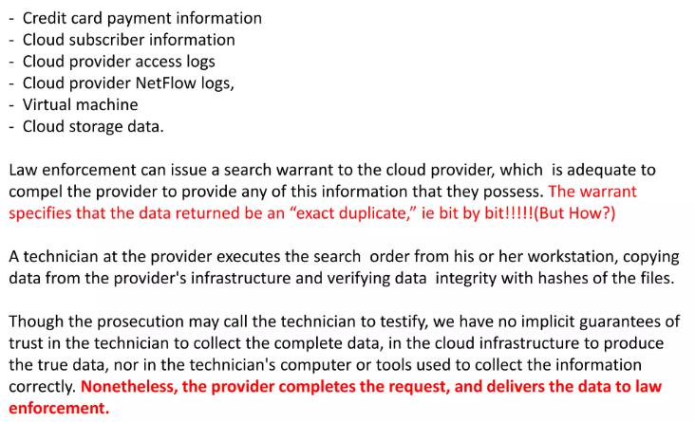
Possible sources of Digital Sources

Slide 15
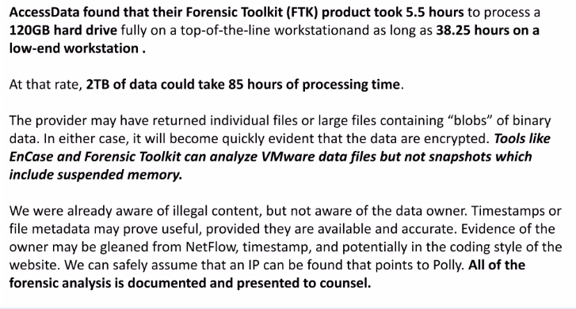
Access Data Information

Slide 16
Next Lecture
Chain of Custody

